Slide 1


Exploring the islamic microfinance products
BADRU JAFFAR SWALEH: SHARIA COORDINATOR, DIB BANK LTD (IN FORMATION)

Slide 2
“Money is such a companion of yours that it does not benefit you unless it leaves you.”
Imam Hasan Al-Basri (d. 694 AD)
(A renowned Muslim scholar)
In the name of God, the Most Gracious, the Ever Merciful

Slide 3
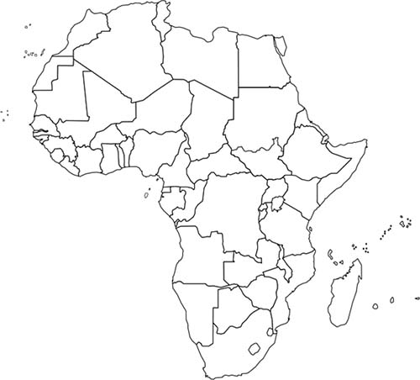
Microfinance In Africa
MFI Geographical Map
1
7 countries hold 50% of continuant's MFIs
7
Nigeria 14%
Kenya 7%
Benin7%
Ghana 6 %
Ivory Coast 6 %
11
Rwanda 6 %
TOGO 6 %
16
8
5
2
1
1
12
1
46
5
1
3
9
3
2
21
9
24
19
19
10
19
10
16
22
1
4
Kenya 14%
Nigeria 12%
4
Ethiopia 12 %
Egypt 11 %
1
7
6
Morocco 8 %
5 countries serving 50% of continuant's customers
1
5

Slide 4
Microfinance In Africa
MFI Attitude
MFIs are depending strongly on individual finance & solidarity individual –groups finances with one product based on weekly basis repayment structure.
ROA average is -3.5%, & - 2.5% ROE, which is considered a very low percentage.
13% is PAR average which considered too high.
19.8% & 51% are the average of personnel & operation cost respectively.

Slide 5
Empowering The Poor
Doing Business With The Poor
Under
Microfinance

Slide 6
Microfinance In Africa
Main Question
Are individuals & groups financing instruments sufficient for MFI to:
Cover needs of the poor and ensure dignified life?
Run MFIs efficiency & with high profitability ?
Rapidly & efficiently penetrate the market ?
Attract Investors & communities ?

Slide 7
Understanding The Concept
  BOP Fortune: for Erick Simons & Stuart Hart “ Colonel University”
If we stop thinking of the poor as victims or as a burden and start recognizing them as resilient and creative entrepreneurs and value-conscious consumers, a whole new world of opportunity will open up.
Thinking of Poor as Partners not only as Customers

Slide 8
Customer Needs Against MFIs’ Products
Are those covered ones (13 M) strongly satisfied ?
Their Projects
Their Personal Needs
Their Technical Knowledge & Service
Direct Investment
Personal & Family needs during Production
Technical Training
Production Quantities & Quality
OPs. Expenses
Marketing
In-Direct & Supportive Investment
Business Management Support

Slide 9



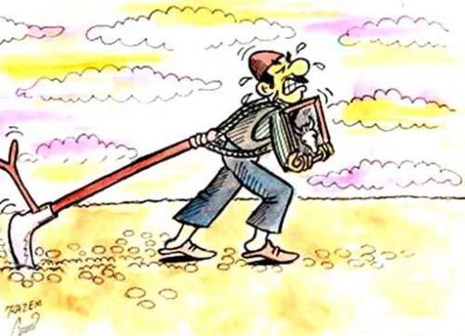


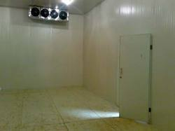

Empowering The Poor Principles
Technical Support
Direct Investment
Quality Inputs
Opportunity of Doing Business with The poor
Managerial Support
....100 Farmers with 1000 Acres with 1000 ton Yield
Storage/Supportive Investment
Marketing
Domestically Export
Standard Product

Slide 10
Business Implementation
Inception Study
Feasibility Study
Supportive Investment
Financial Analysis
Needs Study
The Institutions/Financiers & Partners & Beneficiary’s Community
Opportunity & and profitability Confirmation
Technical & Market Study
Beneficiary & Institution Profitability
Infra-Structure
Finance
Comprehensive Engineered Project
IMFI
Implementation
partners
Community
Beneficiaries /Co-operative/Group Finance
Follow-Up

Slide 11
Application of Innovative & Integrated Islamic Models
Pre-Production
AT Production
After Production
Production Inputs
Murabaha
Production Support
Marketing Support
Mudaraba
Mudaraba
Salam
Bai-Ajil
Istisnaa
Mushraka
Mushraka
Salam
Istisnaa
Ijaraa-Ijaraa Tamlik
Salam
Materials, Machineries ..etc
Personal & Family Needs, Operation Expenses
Cooling Storage, Transportation..etc

Slide 12
Empowering The Poor
Customer interest
Empowering the poor= Access to assets + Access to services + Access to Knowledge + access to market = equal wealth distribution.
Building equipped & organized productive co-operatives/groups.
Strongly facilitate market access & export linking.
Facilitate having international certificates for their products
Provide business solutions to problems.
Easy linking with formal private sector & networks memberships.

Slide 13
Empowering The Poor
MFI interest
Open new services to customers.
Effectively cover large number of targeted segment within certain geographical area at one time.
Effectively finance large number of beneficiaries within limited number of operations ( granting finance, monitoring..)
Facilitate having international certificates for their products.
Insuring Production & Market for a customer is insuring customer repayment & profit sharing.
Equal focus on social & commercial aspects
Building more assets ( IMFIs)

Slide 14
A CASE FOR MICROFINANCE
ISLAMIC FINANCING PRODUCTS

Slide 15
INVESTMENT BASED CONTRACTS– 1. MUDHARABA
Customer
(Mudharib/
fund manager)
Mudharaba Agreement
MFI
(Rab Al Maal/
fund provider)
Pre-agreed ratio/Incentive
Mudharib Expertise
Mudaraba Capital
Mudharaba
PROCESS
FEATURES & EXAMPLES
Mudharaba Agreement between MFI and Customer.
MFI provides capital to be invested by Customer as Mudharib in a Sharia compliant manner
Customer as Mudharib invests the capital as per business plan submitted to the MFI
Return on capital is distributed as per pre agreed ratio either on maturity or periodically (constructive liquidation).
In case of loss, it is borne by Rab Al Maal, save in case of fraud, negligence or misconduct by Mudharib.
Incentive mechanism could be built in to cap the return for the MFI
Bank is Rab Al Mal and Customer is Mudharib.
Also used for project finance
Mudharib cannot guarantee a return, however it may provide an indication.

Slide 16
INVESTMENT BASED CONTRACTS– 2. MUSHARAKA
MFI
(Partner)
Musharaka Agreement
Customer
(Partner)
Pre-agreed ratio/Incentive
Contribution
Contribution
Musharaka
PROCESS
FEATURES & EXAMPLES
Musharaka Agreement between MFI and Customer;
Both provide the capital to be invested;
The Musharaka capital to be provided by the Bank as per agreed business plan
Return on capital is distributed in pre agreed ratio either on maturity or periodically on constructive liquidation.
In case of loss, it is borne pro rata by the parties.
One party, normally Customer, is appointed as the managing partner under separate agreement.
A partner cannot guarantee return for the other.
Managing partner may be provided a performance Incentive.
Used for most types of financing to MFI’s customers, including project finance.

Slide 17
Hybrid Structures - Musharaka and Lease (or forward lease)
Customer
(Partner)
MFI
(Partner)
1
Musharaka Agreement
Lease Agreement
2
5
Rental Payments
4
Purchase Undertaking
3
Sale Undertaking
Explanation of Musharaka and Lease (or forward lease)
Customer and MFI enter into a Musharaka Agreement whereby both contribute capital for the purpose of acquiring certain ready asset.
Upon acquiring the asset, the Bank, as Lessor, leases its share of the Musharaka asset to the Customer.
In case the purpose of Musharaka is construction of the asset, forward Ijara is used instead of normal Ijara.
Purchase Undertaking and Sale Undertaking are also in place to facilitate the disposal as required by the situation.

Slide 18
1. MURABAHA (COST PLUS PROFIT) SALE
FARM INPUTS MURABAHA FINANCE
T₁ Promise to Purchase
MFI
(Seller)
Client
(Purchaser)
T₃ – Murabaha Sale Agreement
T₃ – T_{M} Payment of Deferred Price
T₃ – Sale of Vehicle
T₂ – Delivery of Vehicle
Retailer
(Supplier)
T₂ – Purchase of Vehicle
T₂ – Payment of Price

Slide 19
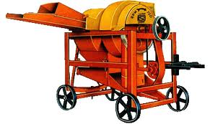
2. ISTISNA (SALE OF DESCRIBED ASSET)
ISTISNA FINANCING
T₄ – T_{M} Payment of Deferred Price
Client
(Purchaser)
MFI
(Seller)
T₁ – Istisna Sale Agreement
T ₄ – Delivery of Machinery
T ₃ – Delivery of Machinery
Retailer
(Supplier)
T₂ – Purchase of Machinery on Parallel Istisna
T₂ – Payment of Price

Slide 20





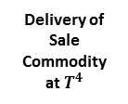




3. SALAM (SALE OF DESCRIBED FUNGIBLE COMMODITIES)
SALAM FINANCING
Payment of Purchase Price at $T^{1}$
MFI
(Purchaser)
Customer
(Seller)
Salam Agreement at at $T^{1}$
Delivery of Described Sale Commodity at at $T^{3}$
Spot Sale of Sale Commodity at $T^{4}$
Delivery of Sale Commodity at $T^{2}$
Delivery of Sale Commodity at $T^{4}$
Payment of Price at $T^{4}$
3rd Party Seller
3rd Party Purchaser
Spot Purchase of Sale Commodity at $T^{2}$
Payment of Price at $T^{2}$

Slide 21

4. IJARA (LEASING)
IJARA (LEASING) FINANCING
T₃ – Service Agency Agreement
T₁ – Promise to Lease
MFI
(Purchaser and Lessor)
T₄ – T_{M} Payment of Rentals
Client
(Lessee)
T₃ – Lease Agreement
T₃ – Lease of Asset
T₃ – Sale Undertaking
T_{M} – Sale of Asset
T₃ – Purchase Undertaking
T₂ – Delivery of Asset
Seller
(Original Owner)
T₂ – Purchase of Asset
T₂ – Payment of Price

Slide 22
Thank you
Badru Jaffar Swaleh
Sharia Coordinator
Certified Sharia Advisor & Auditor (AAOIFI)
DIB Bank Kenya Ltd (In – Formation)
Upper Hill – Opposite Hill park Hotel
P.O. Box 6450 – 00200
Nairobi - Kenya
Tel: +254 709 913 117
Email: badru.swaleh@dibkenya.co.ke
(A subsidiary of Dubai Islamic Bank PJSC)

